Slide 1
Old Apps with new .NET features
Using modern C# language features and packages in legacy projects
Kenny Pflug
Tech Lead at Synnotech

Slide 2
Table of Contents
Erstes Kapitel Überschrift
Zweites Kapitel Überschrift/Headline
Drittes Kapitel Überschrift/Headline
Viertes Kapitel Überschrift/Headline
Usw.

Slide 3
Understanding csproj files

Slide 4
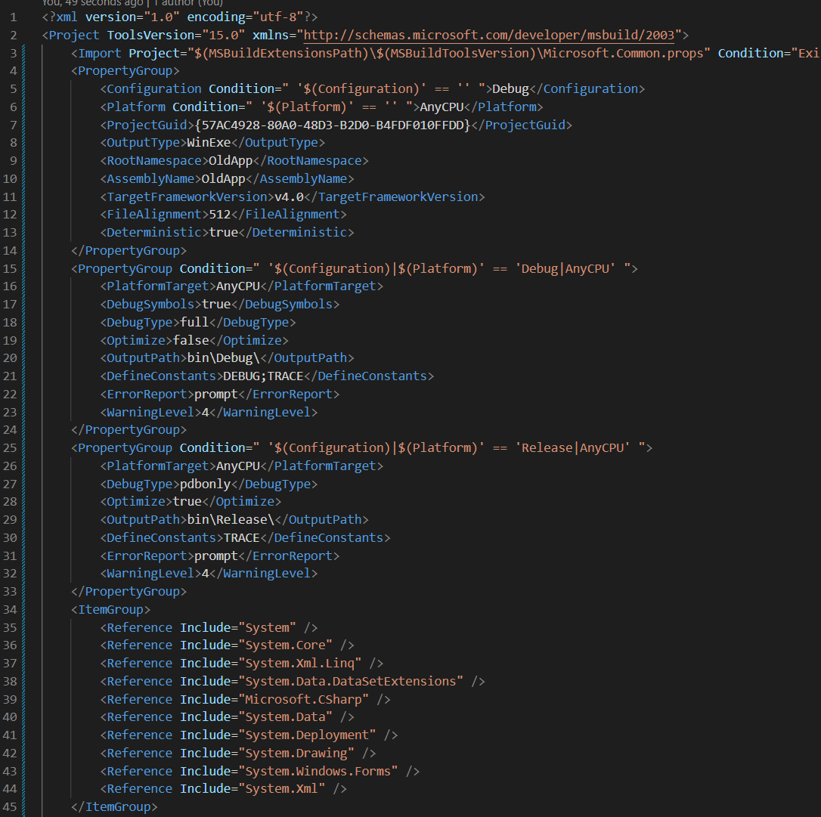
Property Groups and Item Groups
PropertyGroup: values are treated like in a key-value store
ItemGroup: values are treated like in a collection
Condition: a Boolean expression that enables or disables any element (values, groups, etc.)

Slide 5
Important values in csproj files
Old csproj | New csproj | Remark
TargetFrameworkVersion | TargetFramework(s) | Specify the .NET version to build against, necessary in both versions
Configuration | Configuration | Determines if the compiler builds in debug or release mode. Not necessary in new csproj
OutputType | OutputType (default library) | Determines the type of the app (library DLL, console EXE, Windows EXE)
RootNamespace | RootNamespace | Determines the root namespace used for the project. Not necessary in new csproj
AssemblyName | AssemblyName | The name of the output DLL / EXE. Not necessary in new csproj

Slide 6
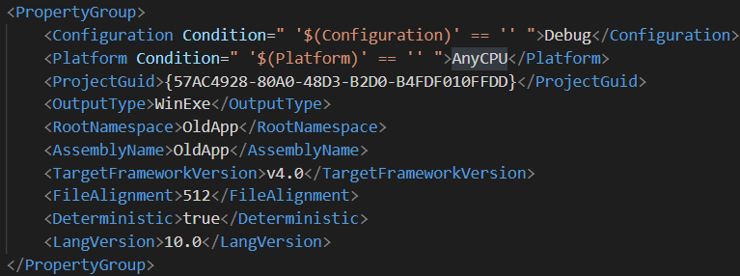
Setting the C# version
Setting LangVersion to a valid C# version allows you to use many new language features that don’t require additional NuGet packages
Beware that your VS / MSBuild version must support your target C# version
VS 2022 -> C# 10.0
VS 2019 -> C# 9.0

Slide 7
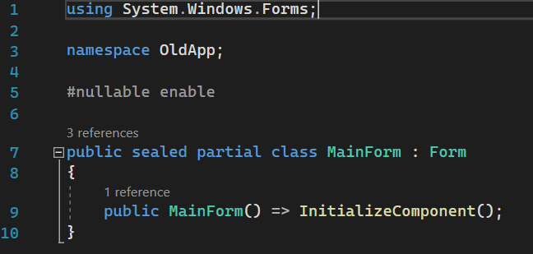
Upgrading to C# 10 enables you to use
Interpolated strings
Pattern Matching
Switch expressions
File-Scoped Namespaces
Get-only Properties
Expression bodies
Local Functions
CallerArgumentExpression
Pattern matching
Top Level Statements
And many more

Slide 8
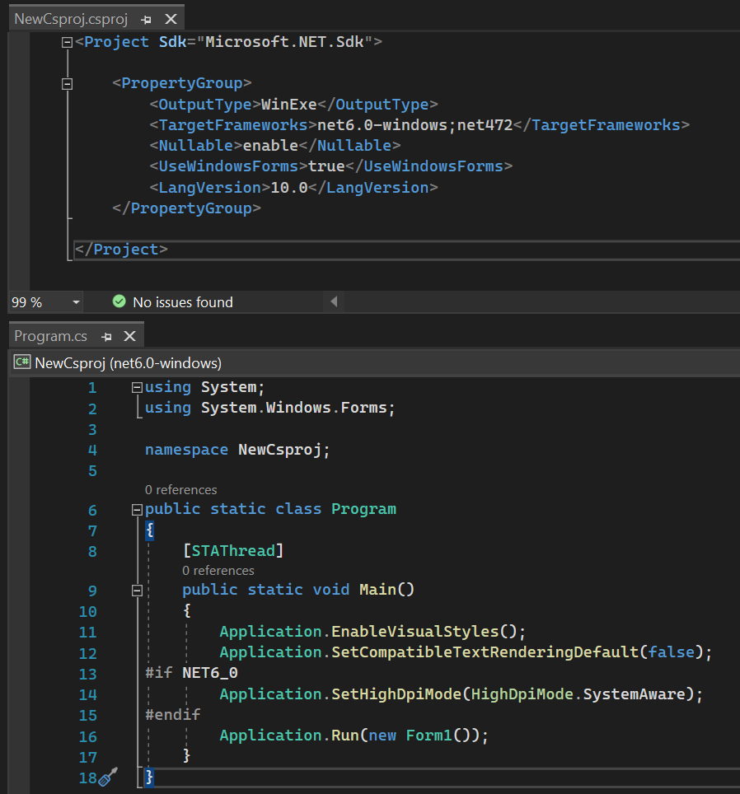
Consider moving to the new csproj format

Slide 9
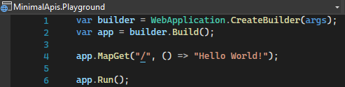
Minimal APIs – Default Template

Slide 10
CreateHostBuilder and Startup are gone
public static class Program
{
public static void Main(string[] args)
{
CreateHostBuilder(args).Build().Run();
}
public static IHostBuilder CreateHostBuilder(string[] args) =>
Host.CreateDefaultBuilder(args)
.ConfigureWebHostDefaults(builder => builder.UseStartup<Startup>());
}
public class Startup
{
public void ConfigureServices(IServiceCollection services)
{
services.AddAuthentication();
services.AddMvc();
}
public void Configure(IApplicationBuilder app,
IWebHostEnvironment environment)
{
if (environment.IsDevelopment())
app.UseDeveloperExceptionPage();
app.UseRouting()
.UseAuthentication()
.UseEndpoints(builder => builder.MapControllers());
}
}
WebApplicationBuilder
WebApplication

Slide 11

Live Demo
ASP.NET Core Minimal APIs Playground
Startup and Configuration

Slide 12
Global Using Directives for Web SDK
using System;
using System.Collections.Generic;
using System.Linq;
using System.Net.Http;
using System.Net.Http.Json;
using Microsoft.AspNetCore.Builder;
using Microsoft.AspNetCore.Hosting;
using Microsoft.AspNetCore.Http;
using Microsoft.AspNetCore.Routing;
using Microsoft.Extensions.Configuration;
using Microsoft.Extensions.DependencyInjection;
using Microsoft.Extensions.Hosting;
using Microsoft.Extensions.Logging;
Source: https://github.com/dotnet/aspnetcore/issues/32451#issuecomment-870812382

Slide 13
Details to HTTP endpoints

Slide 14
Live Demo
Keyfacts:
Bullet/Dummy Text

Slide 15
Vielen Dank!
Ich freue mich auf Feedback!

